Slide 1

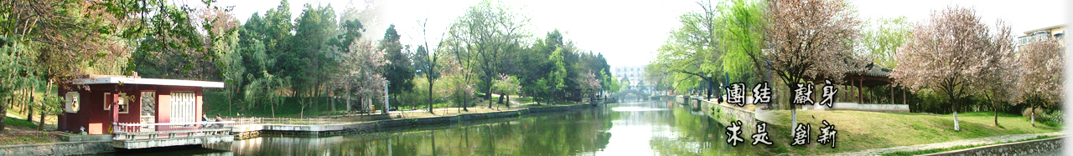
5 Spatial Alignment
EOE Postgraduate Courses
Multi-sensor Data Fusion
wangjingqi@njust.edu.cn

Slide 2
Contents
5.1 Introduction
5.2 Image Registration
5.3 Resample / Interpolation
5.4 Pairwise Transformation T
5.5 Image Fusion
5.6 Mosaic Image

Slide 3
5.1 Introduction
Spatial alignment （空间校准）⎯ the conversion of local spatial positions to a common coordinate system and forms the first stage in the formation of a common representational format.
Image registration（图像配准）⎯ discussion is limited to two-dimensional (x, y) image sensors.

Slide 4
5.2 Image Registration
Definition
The reference image and the test image ⎯ I₁ and I₂ denote two input images, where I_{m}(x, y), m ∈{1, 2}, denotes the gray-level of I_{m} at the pixel (x, y).
The registration process is defined as finding the transformation T which “optimally” maps coordinates in I₁ to coordinates in I₂. Given a pixel (x, y) in I₁, the corresponding location in I₂ is (x’,y’)= T (x, y).
When (x’,y’) does not fall on a pixel in I₂, i.e., no gray-level for the point (x’,y’), we resample/interpolate the test image so that a gray-level is defined for all points (x’,y’).

Slide 5
“Mutual information”.（交互信息）
To find a transformation, which when applied to the test image, will maximize the mutual information between the test and reference images.
Inherent simplicity ⎯ It makes few assumptions regarding the relationship that exists between different images. It only assumes a statistical dependence. The idea is that although different sensors may produce very different images, since they are imaging the same underlying scene, there will exist some inherent mutual information between the images.

Slide 6
Example 5.1. Medical Image Registration
Consider a pair of medical images from different modalities that are in perfect alignment.
At many corresponding spatial locations in the two images, the associated gray-levels will exhibit a consistent mapping.
Whatever the mapping is (one-to-one, one-to-many, many-to-one or many-to-many) the statistical dependency between the images is strong and the mutual information measure has a high value.
When we move out of registration by gradually deforming the test image. The mapping between the gray-levels of the two images will become less consistent, and the value of the mutual information will decrease. In the extreme case, the mutual information will take a value of zero.
Notes:
medical images from different modalities (e. g. Magnetic Resonance and Computerized Tomography).
There will exist some kind of global relation, or mapping, between the gray-levels of the reference image with the gray-levels of the test image.
The mutual information will take a value of zero which signifies that it is not possible to predict any part of one image from the information stored in the other.

Slide 7
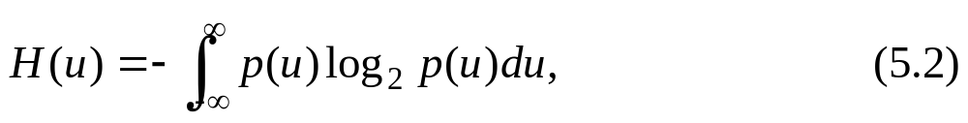
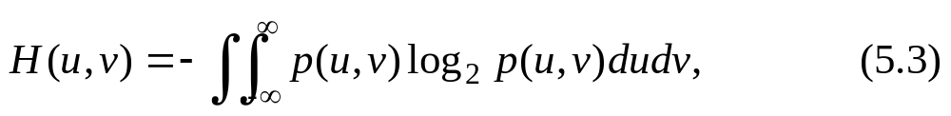
5.2.1 Mutual Information
Definition
The mutual information between two random variables u and v is given by
where H(u), H(v) ⎯ the marginal entropies of u and v; H(u, v) is their joint entropy.
In the continuous domain, the (differential) entropy of a random variable u and the joint (differential) entropy of two random variables u and v are
where p(u), p(u,v) ⎯ the marginal and joint probability density functions of u and v .

Slide 8
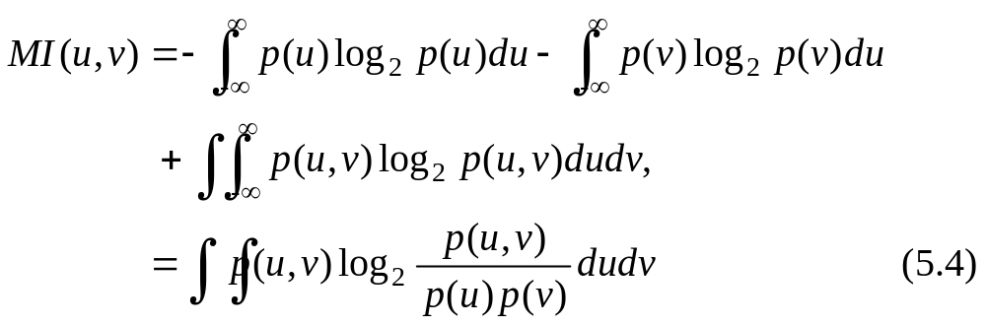
Mathematically, the mutual information can be related to the conditional entropies of u given v and v given u:
H(u) : a measure of the amount of information about u
H(u|v): the amount of uncertainty left in u when v is known.
MI(u,v): the reduction in the uncertainty of u when v is known, i. e. the amount of information that v contains about u.
Notes:
The same analogy can be drawn for the reverse case: a measure of the amount of information that u contains about v.

Slide 9
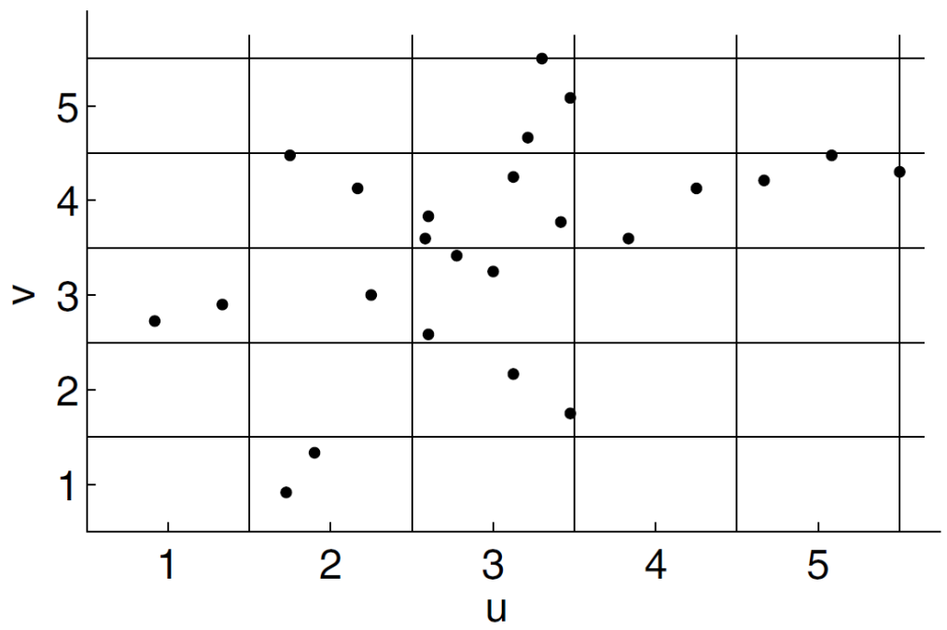
Frequency histogram-based technique
Given N simultaneous measurements (u_{i}, v_{i}), i ∈ {1, 2, . . .,N}, to calculate the mutual information MI(u, v).
Divide the (u, v) into K vertical columns c_{k}, k ∈ {1, 2, . . .,K}, and L horizontal rows r_{l}, l ∈ {1, 2, . . ., L}.
m_{k} and n_{l} are, respectively, the number of simultaneous measurements which lie in c_{k} and r_{l},
m_{kl} is the number of simultaneous measurements (u_{i}, v_{i}), which lie in the intersection of c_{k} and r_{l}, i. e. in the klth bin B_{kl} .
Fig. 5.1. Shows the division of the (u, v) space into KL rectangular bins, where the (k,l)th bin B_{kl} is formed by the intersection of the kth column c_{k} and the lth row r_{l}.
Notes:
Using fixed intervals to divide the (u, v) space into discrete bins.

Slide 10
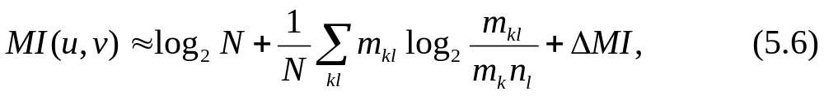
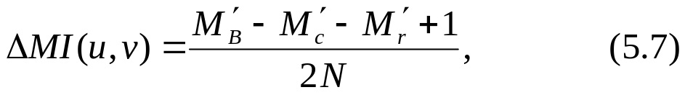
The number of z_{i} = (u_{i}, v_{i}) points:
In the column c₃, m₃ = 12 ;
In the row r₄, n₄ = 11.
In the bin B_{3,4} is m_{3,4} = 4.
then the mutual information is defined as
ΔMI is a systematic error correlation term
where M’_{B}, M’_{c} and M’_{r} ⎯⎯ the number of bins, columns and rows which are not empty。
Notes:
Using fixed intervals to divide the (u, v) space into discrete bins.

Slide 11
An adaptive partitioning method
A hierarchy of partitions ⎯ recursively divide the (u, v) plane into smaller and smaller bins.
Idea: Regions in the (u, v) plane, where the simultaneous measurements (u_{i}, v_{i}) are uniformly distributed, cease to contribute further to the estimated mutual information under further partitioning.
Result: Dense regions containing many simultaneous measurements are covered with small bins, while regions containing few, or no, simultaneous measurements are covered with large bins.
Systematic errors.
Reasons: approximating MI(x, y) by a finite sum.
Notes:
Instead of using fixed intervals to divide the (u, v) space into discrete bins, we may improve the MI(u, v) estimate by using an adaptive partitioning method.

Slide 12
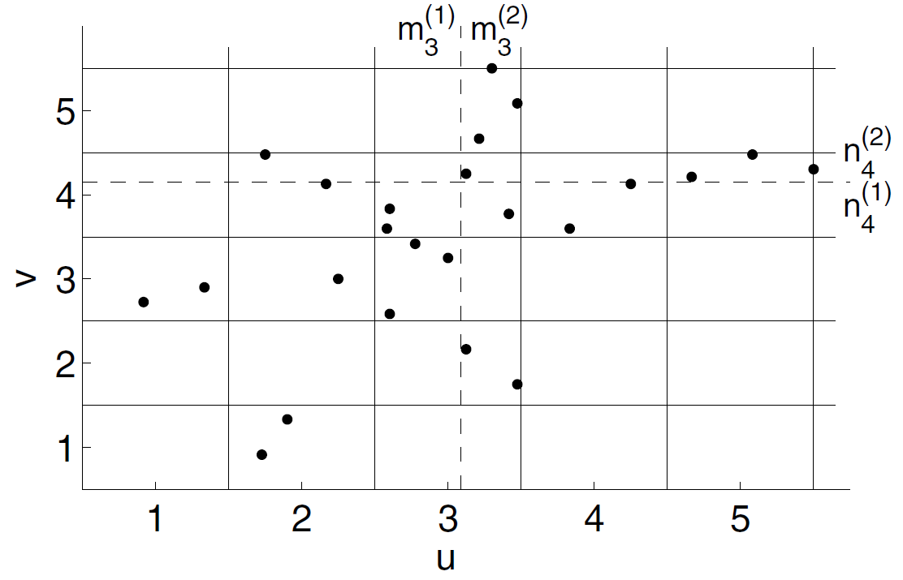
Example 5.2. Darbellay-Tichavsky Variable Partitioning Algorithm .
A rectangular bin B_{kl} which contains m_{kl} > 4 pairs of measurements: the corresponding vertical column and horizontal row contain, respectively, m_{k} and n_{l} measurement pairs.
dividing c₃ into two vertical sub-columns: m₃⁽¹⁾ = 5 and m₃⁽²⁾= 7;
dividing r₄ into two horizontal sub-rows: n₄⁽¹⁾ = 4 and n₄⁽²⁾ =6.
| m_{k}⁽¹⁾ − m_{k}⁽²⁾| and |n_{l}⁽¹⁾ − n_{l}⁽²⁾| are as close to zero as possible.
Fig. 5.2. Shows the division of the bin B_{3,4} into four rectangles.
Dividing B_{kl} into four rectangular sub-bins containing m_{kl}⁽¹⁾, m_{kl}⁽²⁾, m_{kl}⁽³⁾and m_{kl}⁽⁴⁾measurement pairs.
The vertical columns contain m_{k}⁽¹⁾ and m_{k}⁽²⁾ measurement pairs.
The horizontal rows contain n_{l}⁽¹⁾and n_{l}⁽²⁾measurement pairs.
Notes:
A variable partitioning MI algorithm.

Slide 13
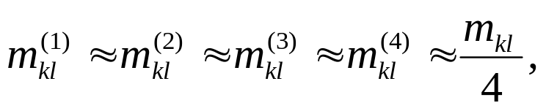
If the resulting sub-bins satisfy the equality:
then the division of B_{kl} is not carried out. Instead the bin remains unchanged.
Kernel method
Instead of using discrete bins we may use continuous bins, or kernels, to calculate the probability densities p(u), p(v) and p(u,v). This is known as kernel, or Parzen-window, density estimation.
Both the histogram and the kernel methods are based on the idea of a “bin”.

Slide 14
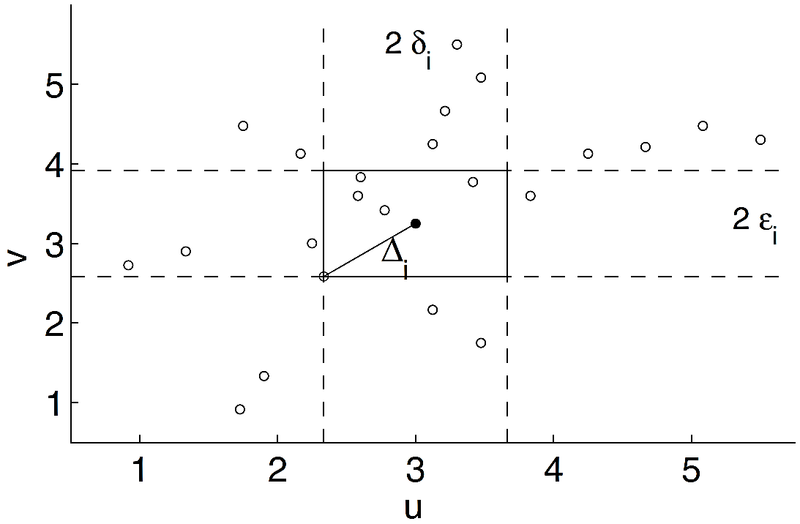
“Binless” approach
If z_{i} = (u_{i}, v_{i}), then we define the distance between two points, z_{i} and z_{j}, as
Δ_{i} ⎯ the Euclidean distance from z_{i} to its k-nearest neighbor,
δ_{i} and ε_{i} ⎯ the corresponding distances projected along the u and v axes.
Fig. 5.3. Calculation of δ_{i} and ε_{i} for the point z_{i} = (u_{i}, v_{i}).
The rectangle surrounding z_{i} contains k = 5 points (apart from z_{i} ).
We join z_{i} with the fifth point which is furthest from z_{i} with a straight line whose (Euclidean) length is Δ_{i}.

Slide 15
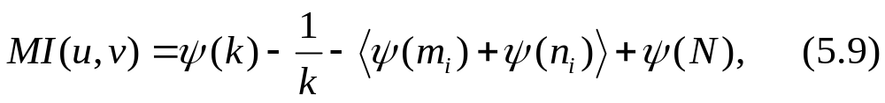
The estimate for the mutual information is
m_{i} and n_{i} ⎯ the number of points with ||u_{i} − u_{j} ||≤ δ_{i} and ||v_{i} − v_{j} ||≤ε_{i},
ψ ⎯ the digamma function, calculated using the recursion relation,
< > denotes an average over all i, i ∈ {1, 2, . . .,N}.

Slide 16
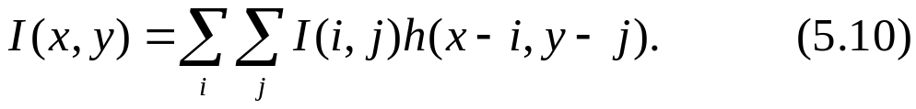
5.3 Resample/Interpolation （重采样/内插）
to uniquely define the behavior of the transformation T when the samples do not fall on a pixel.
Image interpolation
we reconstruct a two-dimensional continuous image I(x, y) from its discrete pixel values I(i, j). ⎯ modeled as a convolution of the discrete image samples with a continuous two-dimensional impulse response h(x, y):
Symmetrical and separable interpolation kernels are used to reduce the computational complexity,
The fixed coefficient kernels listed in Table 5.1; the spatial Kriging estimators listed in Table 4.3.

Slide 17
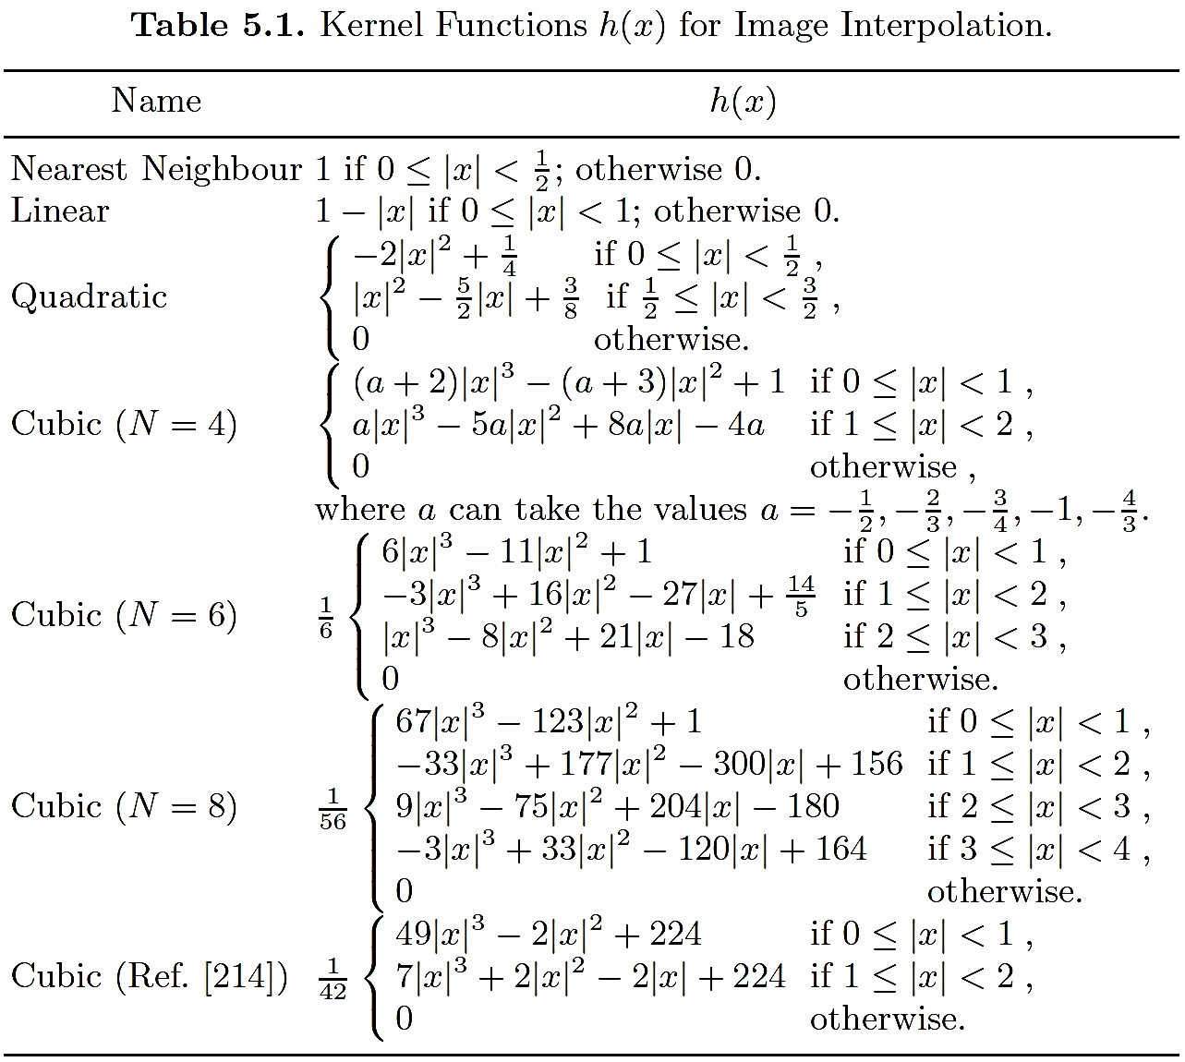
Notes:
各种形式的加窗。

Slide 18
Effect of resampling on mutual information
The process of resampling/interpolation introduces new gray-levels which may interfere with the computation of the MI.
E.g., in applications involving remote sensing, nearest neighbour interpolation is often found to perform better than either linear, or cubic convolution, interpolation.
Example 5.3. Entropy Changes and Interpolation.
Consider a 10 × 10 binary image centered on a step function.
The linear interpolation of this image after a very small sub-pixel translation across the edge introduces 10 new members with a third gray-level.
Before translation the entropy of the image is H = 1. After translation the entropy is H =1.03 + 0.33, the last value being the contribution of the new gray-level which represents 10% of all pixels.

Slide 19
5.4 Pairwise Transformation T （成对变换）
Definition:
(x’, y’)= T (x, y)
⎯ a mathematical relationship that maps a spatial location (x, y) in one image to a new location, (x’,y’), in another image.
Applications:
——to remove optical distortions introduced by a camera or a particular viewing perspective
——to register an image with a given map or template
——or simply to align two input images.

Slide 20
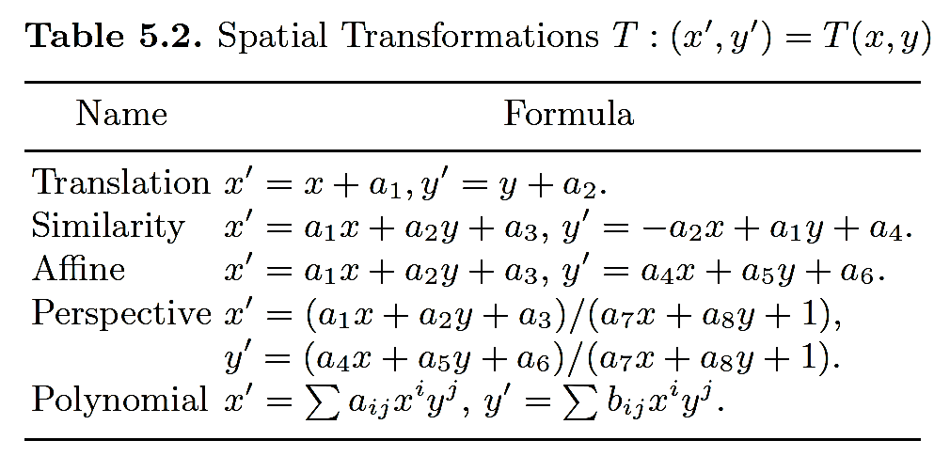
The choice of transformation is always a compromise between a smooth distortion and a distortion which achieves a good match.
One way to ensure smoothness is to assume a parametric form of low-order for the transformation such as that given in Table 5.2.

Slide 21
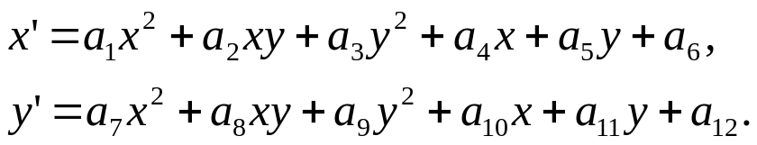
Physical arguments are used to derive the transformation T .
Example 5.4. Transformation for Retinal Images （视网膜图像）.
model the retina as a quadratic surface（二次曲面） and assume a rigid weak-perspective transformation（刚性的弱透视变换）between the two images, then the corresponding transformation is
The assumptions made in deriving this transformation may be justified on physical grounds.

Slide 22
“Non-rigid” transformation（非刚性变换）
In the case that the images undergo local deformations, we cannot describe the alignment of two images using a single low-order transformation.
A “non-rigid” transformation is written as a sum of a low-order global transformation T_{global}(x, y) and a local transformation T_{local}(x, y):
where the parameters of T_{local} change with (x, y).

Slide 23
Example 5.5. Spatial Alignment in Cardiac MR Images .
Magnetic imaging (MR) of the cardiovascular system is playing an increasingly important role in the diagnosis and treatment of cardiovascular diseases.
During a cardiac cycle the heart changes size and shape.
To perform spatial alignment of two MR images taken at different times, during the cardiac cycle we therefore require a transformation T(x, y) which includes both a global transformation and a local transformation.
The purpose of the local transformation T_{local}(x, y) is to correct for changes in the size and shape of the heart. We often use a product of one-dimensional cubic splines（三次样条函数） for this purpose.

Slide 24
5.5 Image Fusion
combining information from multiple spatially registered images.
Pan-Sharpening
Question ⎯ In capturing a high-resolution multi-spectral image, we can either use a panchromatic sensor or a multispectral sensor.
The images taken with the panchromatic sensor have high spatial resolution but low spectral resolution, while the images taken with the multi-spectral sensor have high spectral resolution but low spatial resolution.
co-Kriging ⎯ to create a new image characterized by a high-spatial resolution and a high-spectral resolution.

Slide 25
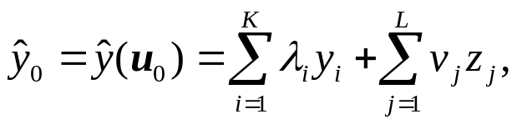
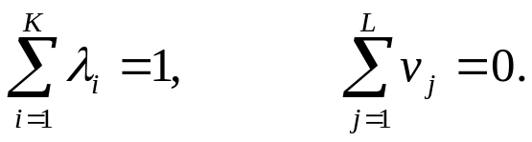
Example 5.6. Image Fusion: Pan-Sharpening Using Co-Kriging.
two types of variables: high spectral resolution data y and high spatial resolution data z.
The multi-spectral image is interpolated at some point u₀ by a linear combination of y and z:
where y_{i}, ⎯ the high spectral resolution gray-levels at K nearby locations and z_{j}, ⎯ the high spatial resolution gray levels at L nearby locations.
the weights λ_{k} and ν_{l} ⎯ chosen to give the best (in the least square sense) unbiased solution subject to the following constraints:

Slide 26
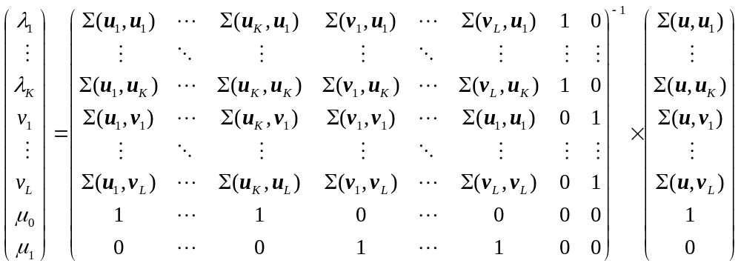
Solution:
where μ₀ and μ₁ are two Lagrange multipliers.
Note: The co-Kriging procedure can be interpreted as the application of a low-pass filter to y(u) and a high pass filter to z(u) .

Slide 27
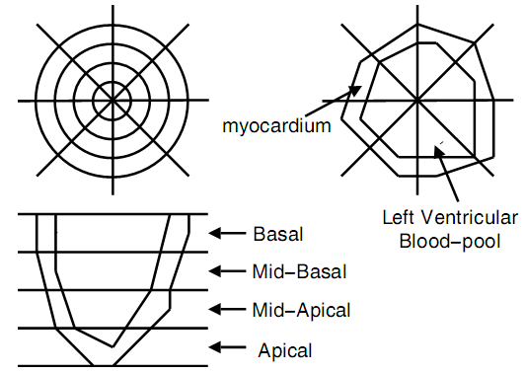
Fusion of PET and MRI Images
The fusion of PET and MRI images is concerned with image fusion between complementary sensors in which the output is a decision surface or image.
In the decision image each pixel gray-level represents a given decision. In forming the decision surface we reduce the effects of spatial misregistration by using a low resolution polar map or common representational format (see Ex. 4.8).
Fusion of PET and MRI
The images are first converted to low-resolution polar maps which are then spatially registered.
Parameters are extracted from each sector in the co-aligned PET and MRI polar maps which are then fused together using a single fusion cell F.
The fusion in F is performed using the fuzzy logic truth table.

Slide 28
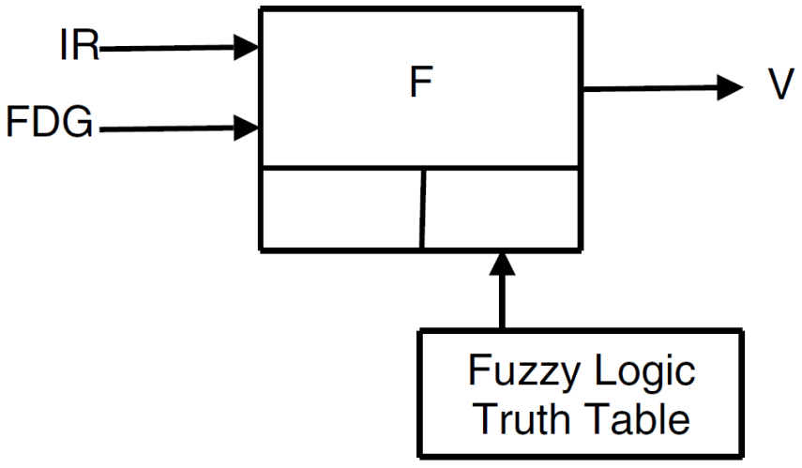
Example 5.7. Multi-Modal Cardiac Imaging.
Different imaging sensors give specific views of the phenomenon.
Fig. 5.4. Fusion of the MRI and PET images using a single fusion cell F.
input ⎯ the Inotropic Reserve, IR, derived from the MRI image and the 18-fluorodeoxyglucose, FDG, derived from the PET image.
output ⎯ the myocardial viability V, a decision image in which each pixel gray-level corresponds to a linguistic myocardial viability value.
The fusion is performed using a fuzzy logic truth table which is supplied as external knowledge.

Slide 29
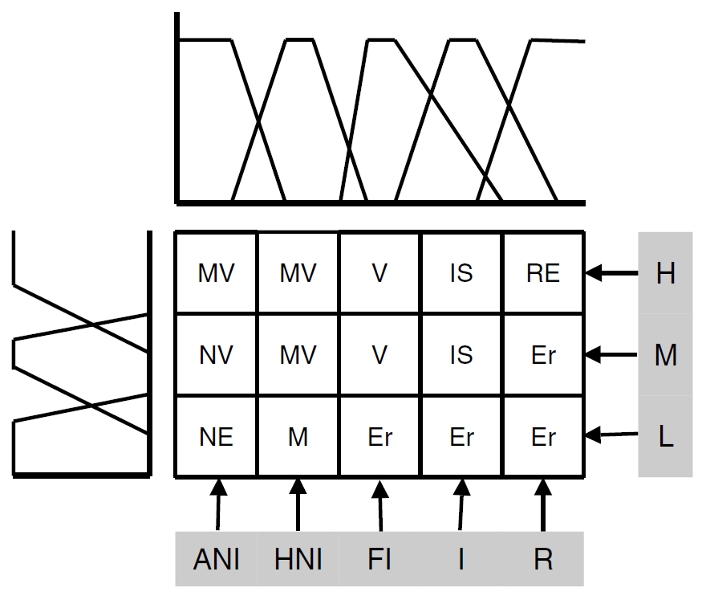
Side graph ⎯ the three membership functions associated with the linguistic values (H, M, L) of the FDG parameter.
Top graph ⎯ the five membership functions associated with the linguistic values (ANI, HNI, FI, I, R) of the IR parameter.
inputs ⎯ IR (horizontal axis) which is derived from the MRI image and FDG (vertical axis) which is derived from the PET image.
output variable V : Necrosis (NE), Maimed (M), Metabolic Viable (MV), Viable (V ), Ischemic (IS), Remote (RE) and Error (Er), where the error Er is used to express an impossible combination of input values.
Fig. 5.5. The fuzzy logic truth table used to fuse the IR and the 18-FDG parameters.

Slide 30
5.6 Mosaic Image（拼接图像）
Building a mosaic image from a sequence of partial views is a powerful means of obtaining a broader view of a scene than is available with a single view.
Functions T_{m} is needed to transform each input image I_{m} onto the image I∗ .
Research on automated mosaic construction is ongoing with a wide range of different applications.
Example 5.8. Mosaic Fingerprint Image .
In fingerprint-based verification systems, the solid-state sensors sense only a limited portion of the fingerprint pattern and this may limit the accuracy of the user verification.
To deal with this problem we may construct a mosaic fingerprint image from multiple fingerprint impressions.
Notes:
Fingerprint-based verification systems have gained immense popularity due to the high level of uniqueness attributed to fingerprints and the availability of compact solid-state fingerprint sensors.

Slide 31
Example 5.9. Mosaic Image of the Retina（视网膜）.
One area in which mosaic images are particularly valuable is in the diagnosis and treatment of diseases of the retina. A seamless mosaic image which is formed from multiple fundus camera images aids in the diagnosis and provides a means for monitoring the progression of different diseases.
It may also be used as a spatial map of the retina during surgical treatment.
Notes:
PET ⎯ positron emission tomography; MRI ⎯ magnetic resonance imaging

Slide 32
How to build a mosaic image ?
Theoretically, if one image can be established as an anchor “image” I₀ on which to base the mosaic image I∗, then the transformation of each remaining images onto this anchor may be estimated using pairwise registration, and the transformed images may be combined.
In practice, this approach does not work for two reasons:
Some images may not overlap with the anchor image at all or have insufficient overlap. This makes a direct computation of the transformation impossible.
  The Straightforward solution is to compose transformations using an “intermediate” image.
2. The transformations T_{m} may be mutually inconsistent.
One approach to solving this problem is to jointly estimate all of the image-to-mosaic transformations T_{m}.
Notes:
PET ⎯ positron emission tomography; MRI ⎯ magnetic resonance imaging

Slide 33

Thank you for your attention!

